Slide 1




Introducing the gt Package
Rich Iannone
rich-iannone
@riannone
rich@rstudio.com

Slide 2
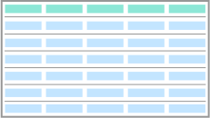
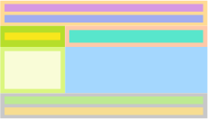
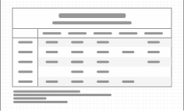
the gt package
Lets you build display tables with easy-to-use functions
Table outputs can be HTML, LaTeX, and RTF
Available on GitHub
the basic workflow
table data
gt object
gt table
tibble or
data frame
modifiable with the
all the functions
as HTML, LaTeX,
or RTF
What are some useful features in display tables?

Slide 3
the gt package
Lets you build display tables with easy-to-use functions
Table outputs can be HTML, LaTeX, and RTF
Available on GitHub
the basic workflow
table data
gt object
gt table
tibble or
data frame
modifiable with the
all the functions
as HTML, LaTeX,
or RTF
What are some useful features in display tables?

Slide 4
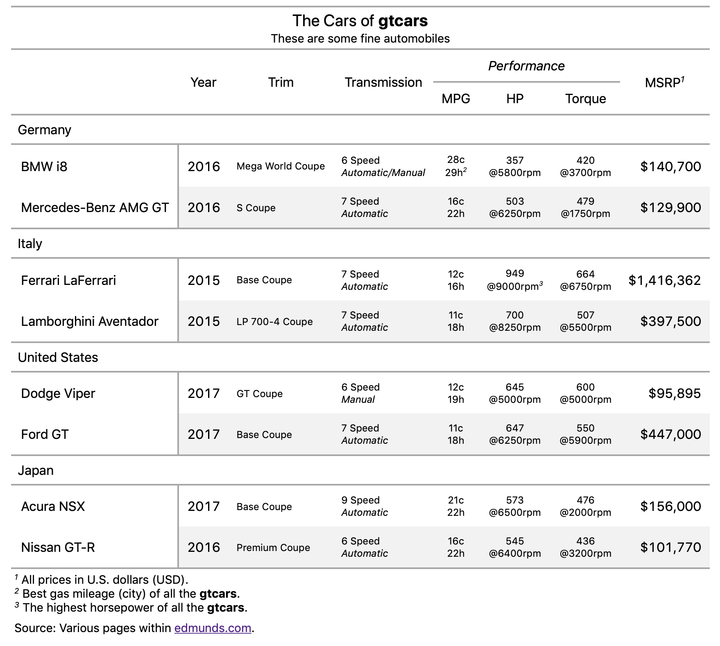
the gt package
Lets you build display tables with easy-to-use functions
Table outputs can be HTML, LaTeX, and RTF
Available on GitHub
the basic workflow
table data
gt object
gt table
tibble or
data frame
modifiable with the
all the functions
as HTML, LaTeX,
or RTF
What are some useful features in display tables?
table header
with a title and a subtitle
column labels
along with column grouping
row labels
data formatting
along with row grouping
flexibly transform data for presentation
footnotes
in the right order

Slide 5
What are some useful features in display tables?
1
2
3
1
2
footnotes
3
in the right order

Slide 6
Structural
The Structural
The
We Need Some Structure for a Table;
the Parts of It.

Slide 7
Structural
The Structural
The
The Structural Parts of a Table
This is the most basic form of a gt table
stub
head
column
label
stubhead label
column
label
column
label
column labels
cell
row label
cell
cell
cell
row label
cell
cell
stub
table body
cell
row label
cell
cell
cell
row label
cell
cell

Slide 8
The Structural Parts of a Table
stub
head
stubhead label
column
label
column
label
column
label
title
column labels
subtitle
row group label
row label
cell
cell
cell
row label
cell
cell
cell
stub
table body
row label
cell
cell
cell
summary label
row label
summary cell
cell
cell
cell
summary cell
summary cell
A table stub is not always needed but it can be useful!

Slide 9
The Structural Parts of a Table
table
header
title
subtitle
stub
head
stubhead label
column
label
column
label
column
label
column labels
row group label
cell
cell
cell
row label
cell
cell
cell
stub
table body
row label
cell
cell
cell
footnotes
summary label
summary cell
summary cell
summary cell
source notes
A table header is a great place to add a title and a subtitle

Slide 10
The Structural Parts of a Table
table
header
title
subtitle
stub
head
stubhead label
column
label
column
label
column
label
column labels
row group label
cell
cell
cell
row label
cell
cell
cell
stub
table body
row label
cell
cell
cell
summary label
summary cell
summary cell
summary cell
footnotes
table
footer
source notes

Slide 11
Do We Have the Functions to Get These
Display Tables Made?
YES!

Slide 12
The Functions for Making Display Tables
Create Table
use this first
 |  | gt() | Create a gt table object
once the table data is ready
%>% gt()
table data
gt object
gt table
tibble or
data frame
modifiable with the
all the functions
as HTML, LaTeX,
or RTF
Format Data
 |  | fmt_number() | Format numeric values
 |  | fmt_scientific() | Format values to scientific notation
 |  | fmt_percent() | Format values as a percentage
 |  | fmt_currency() | Format values as currencies
 |  | fmt_date() | Format values as dates
 |  | fmt_time() | Format values as times
 |  | fmt_datetime() | Format values as date-times
 |  | fmt_missing() | Format missing values

Slide 13
The Functions for Making Display Tables
Create Table
use this first
 |  | gt() | Create a gt table object
once the table data is ready
❶
❷
use of tidyr,
dplyr, etc.
%>% gt()
table data
table data
gt object
requires tidying, summarizing, etc.
tibble or
data frame
modifiable with the
all the functions
Format Data
 |  | fmt_number() | Format numeric values
 |  | fmt_scientific() | Format values to scientific notation
 |  | fmt_percent() | Format values as a percentage
 |  | fmt_currency() | Format values as currencies
 |  | fmt_date() | Format values as dates
 |  | fmt_time() | Format values as times
 |  | fmt_datetime() | Format values as date-times
 |  | fmt_missing() | Format missing values

Slide 14

The Functions for Making Display Tables
Create Table
 |  | gt() | Create a gt table object
Create/Modify Parts
 |  | tab_header() | Add a table header
 |  | tab_spanner() | Add a spanner column label
 |  | tab_row_group() | Add a row group
 |  | tab_stubhead_label() | Add label text to the stubhead
 |  | tab_footnote() | Add a footnote
 |  | tab_source_note() | Add a source note citation
gt object
Use as many (or as few) of these as you need!
Format Data
 |  | fmt_number() | Format numeric values
 |  | fmt_scientific() | Format values to scientific notation
 |  | fmt_percent() | Format values as a percentage
 |  | fmt_currency() | Format values as currencies
 |  | fmt_date() | Format values as dates
 |  | fmt_time() | Format values as times
 |  | fmt_datetime() | Format values as date-times
 |  | fmt_missing() | Format missing values

Slide 15
The Functions for Making Display Tables
Create Table
 |  | gt() | Create a gt table object
Create/Modify Parts
Format Data
 |  | tab_header() | Add a table header
 |  | tab_spanner() | Add a spanner column label
 |  | tab_row_group() | Add a row group
 |  | tab_stubhead_label() | Add label text to the stubhead
 |  | tab_footnote() | Add a footnote
 |  | tab_source_note() | Add a source note citation
 |  | fmt_number() | Format numeric values
 |  | fmt_scientific() | Format values to scientific notation
 |  | fmt_percent() | Format values as a percentage
 |  | fmt_currency() | Format values as currencies
 |  | fmt_date() | Format values as dates
 |  | fmt_time() | Format values as times
 |  | fmt_datetime() | Format values as date-times
 |  | fmt_missing() | Format missing values
gt object
These make the data appear as you want the data to appear.

Slide 16
The Functions for Making Display Tables
Create Table
 |  | gt() | Create a gt table object
before
after
Create/Modify Parts
Format Data
 |  | tab_header() | Add a table header
 |  | tab_spanner() | Add a spanner column label
 |  | tab_row_group() | Add a row group
 |  | tab_stubhead_label() | Add label text to the stubhead
 |  | tab_footnote() | Add a footnote
 |  | tab_source_note() | Add a source note citation
 |  | fmt_number() | Format numeric values
 |  | fmt_scientific() | Format values to scientific notation
 |  | fmt_percent() | Format values as a percentage
 |  | fmt_currency() | Format values as currencies
 |  | fmt_date() | Format values as dates
 |  | fmt_time() | Format values as times
 |  | fmt_datetime() | Format values as date-times
 |  | fmt_missing() | Format missing values
numeric_col
numeric_col
0.135
0.1
5.924
5.9
803.643
803.6
6271.201
6,271.2
Formatting numbers is super simple.
decimals = 1

Slide 17
The Functions for Making Display Tables
Create Table
 |  | gt() | Create a gt table object
before
after
Format Data
 |  | fmt_number() | Format numeric values
 |  | fmt_scientific() | Format values to scientific notation
 |  | fmt_percent() | Format values as a percentage
 |  | fmt_currency() | Format values as currencies
 |  | fmt_date() | Format values as dates
 |  | fmt_time() | Format values as times
 |  | fmt_datetime() | Format values as date-times
 |  | fmt_missing() | Format missing values
numeric_col
numeric_col
0.135
€0,14
5.924
€5,92
803.643
€803,64
6271.201
€6 271,20
gt knows about currencies… and locales!
currency = “EUR”
$€¥£₽₨₩฿₺₮₱₭₴₦₹₲₪₡₵₢₳₥₯
locale = “fr_FR”

Slide 18
The Functions for Making Display Tables
Create Table
 |  | gt() | Create a gt table object
before
after
Format Data
 |  | fmt_number() | Format numeric values
 |  | fmt_scientific() | Format values to scientific notation
 |  | fmt_percent() | Format values as a percentage
 |  | fmt_currency() | Format values as currencies
 |  | fmt_date() | Format values as dates
 |  | fmt_time() | Format values as times
 |  | fmt_datetime() | Format values as date-times
 |  | fmt_missing() | Format missing values
numeric_col
numeric_col
0.135
0.135
NA
—
803.643
803.643
NA
—
Those pesky NAs can be replaced!

Slide 19
There are many more functions… just no time to even mention them here :(

Slide 20
It’s Now Time for Some Demos

Slide 21



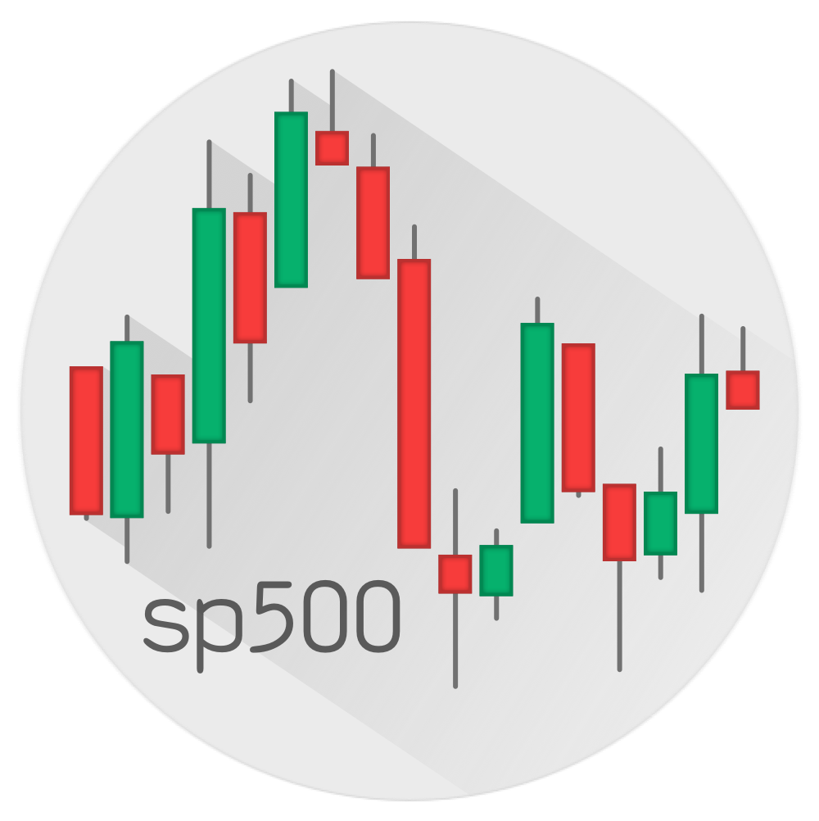


It’s Now Time for Some Demos
The gt package comes with six example datasets
Let’s take a look at some simple examples with exibble…

Slide 22
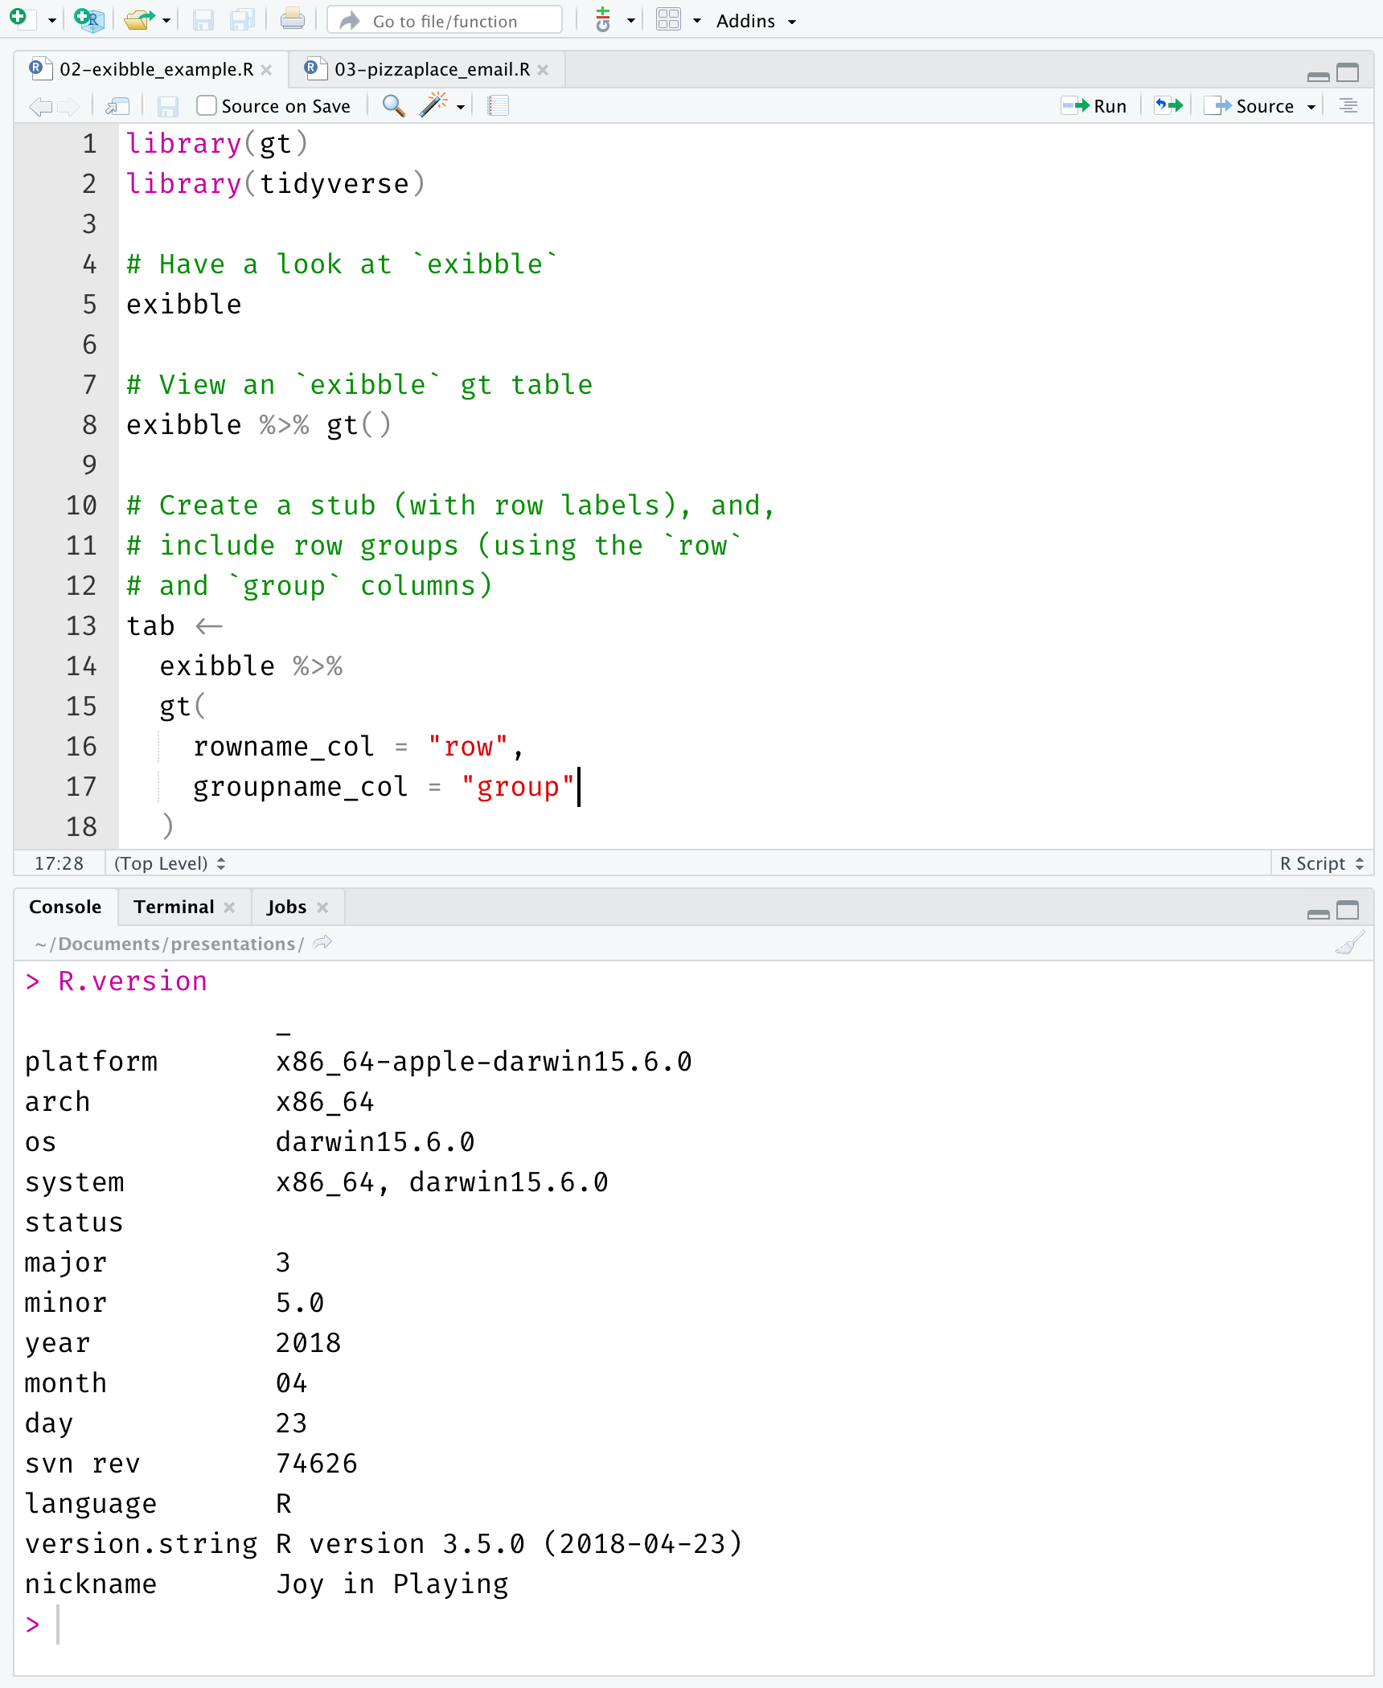



It’s Now Time for Some Demos
Let’s take a look at some simple examples with exibble…
Let’s head over to:
exibble
…and we’ll take a quick look at emailing a gt table
pizzaplace
table data
gt object
gt table
email
tibble
tibble (summarized)
modifiable with the
all the functions
inlined HTML
Sent via an
emailing package
https://github.com/rstudio/gt
https://github.com/rich-iannone/presentations

Slide 23
It’s Now Time for Some Demos
Let’s take a look at some simple examples with exibble…
Let’s head over to:
exibble
…and we’ll take a quick look at emailing a gt table
pizzaplace
table data
gt object
gt table
email
tibble
tibble (summarized)
modifiable with the
all the functions
inlined HTML
Sent via an
emailing package
https://github.com/rstudio/gt
https://github.com/rich-iannone/presentations

Slide 24

Let’s head over to:
https://github.com/rstudio/gt
https://github.com/rich-iannone/presentations

